Slide 1
Soil analysis using machine learning
By: Mahmood Yousaf
Supervisor: Dr Malik Jahan Khan

Slide 2
Agenda
Problem statement
Proposed solution
Dataset
Methodology
Results
Future plan
Questions

Slide 3




Problem Statement
Time consuming
Soil sample
Laboratory Testing
More Cost
Soil analysis using machine learning

Slide 4
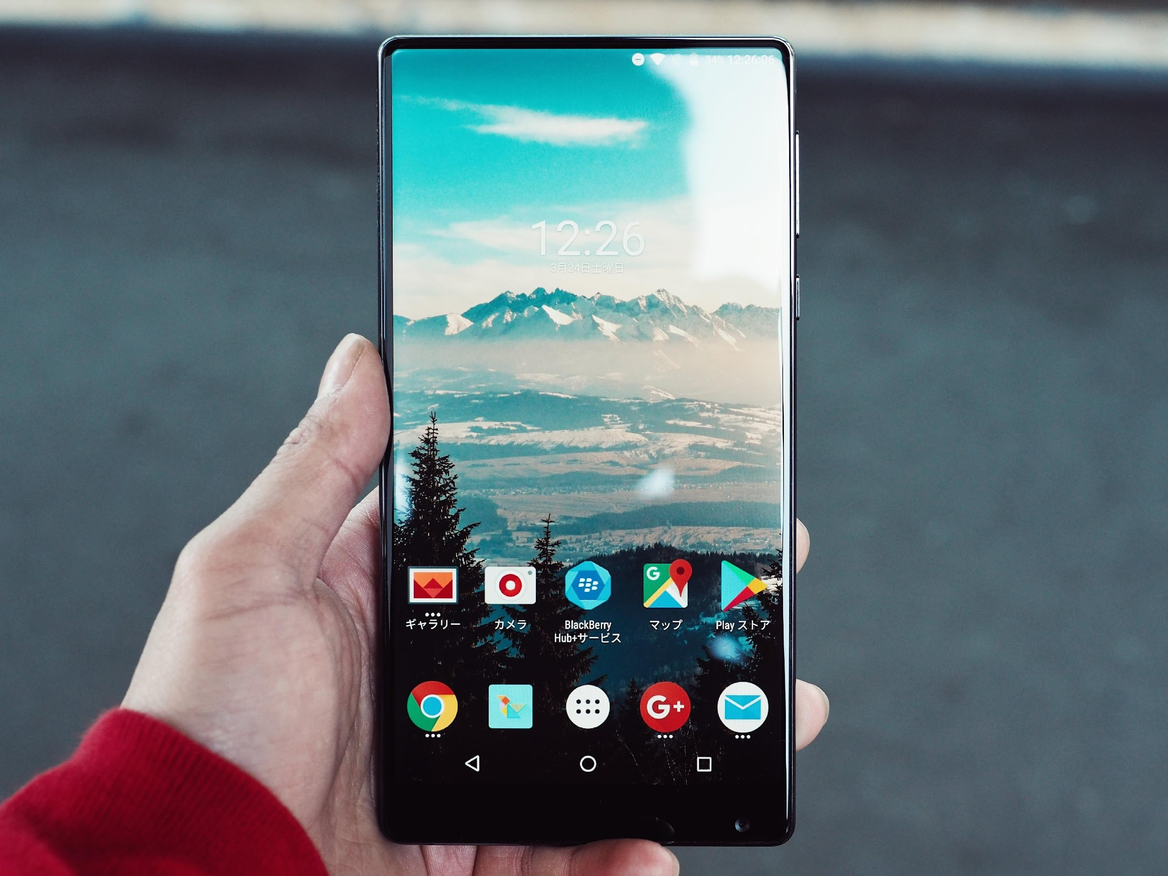
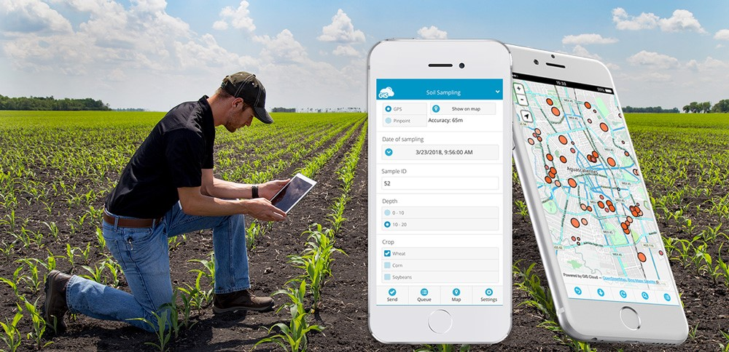

Solution
Provide Report
Fertilizer recommendations
Mobile Application
Soil Sampling
AI models
Soil analysis using machine learning

Slide 5
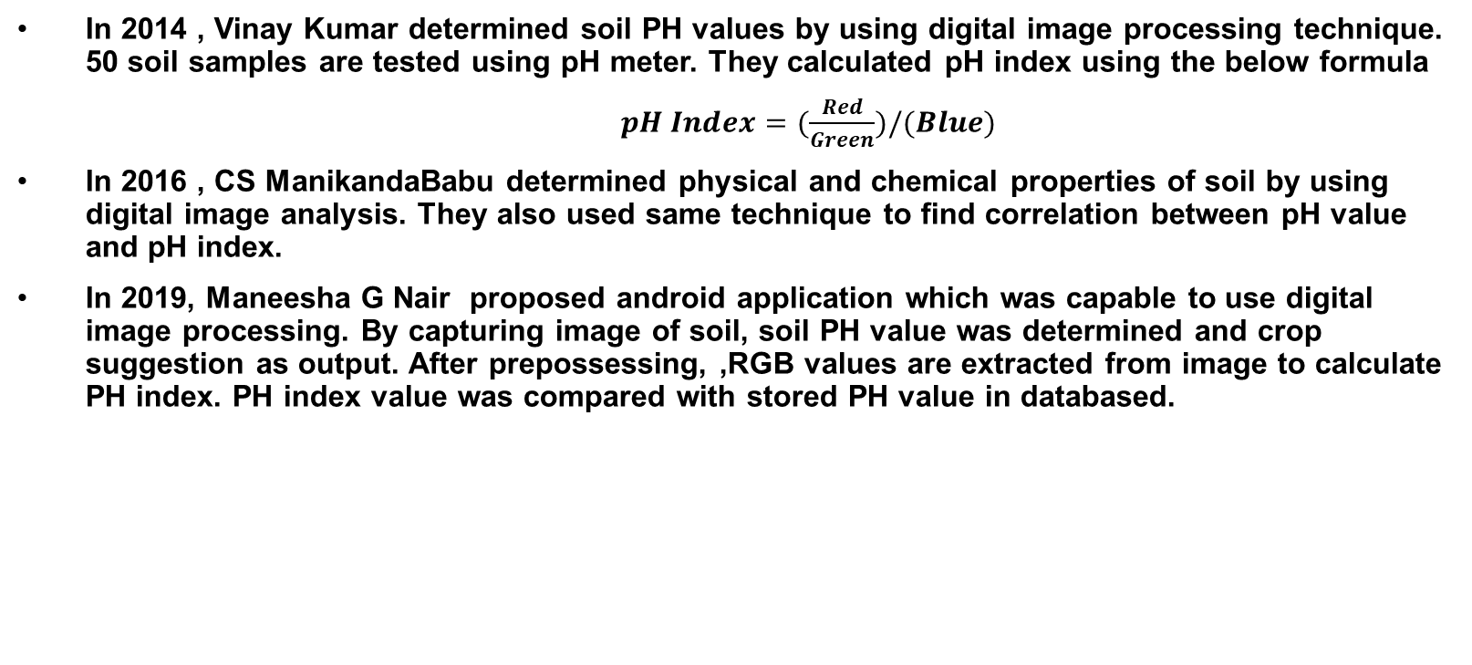
Literature review
In 2014 , Vinay Kumar determined soil PH values by using digital image processing technique. 50 soil samples are tested using pH meter. They calculated pH index using the below formula
$pH Index=(\frac{Red}{Green})/(Blue)$
In 2016 , CS ManikandaBabu determined physical and chemical properties of soil by using digital image analysis. They also used same technique to find correlation between pH value and pH index.
In 2019, Maneesha G Nair proposed android application which was capable to use digital image processing. By capturing image of soil, soil PH value was determined and crop suggestion as output. After prepossessing, ,RGB values are extracted from image to calculate PH index. PH index value was compared with stored PH value in databased.
1/27/2022

Slide 6
Dataset
Dataset is collected by mobile phone camera
Locations are Mianwali, Talagang and Khusab
There are about 4000 soil samples with images
Available ground truth is 1064 soil samples with EC, P, pH and P values
Testing in soil laboratory is in progress
1/27/2022

Slide 7
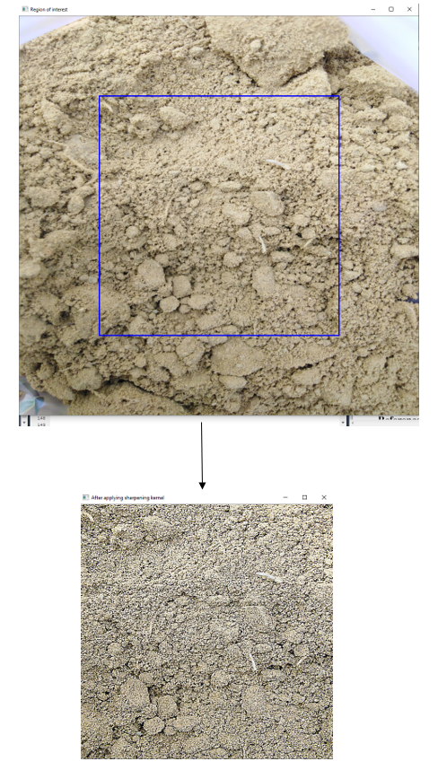
Preprocessing
Image resizing using OpenCV
Extracted ROI
Applying sharpening kernel
Sharpening kernel for dealing with blur effect and some lightening issues
Fig: Extracting ROI and applying sharpening kernel
1/27/2022

Slide 8
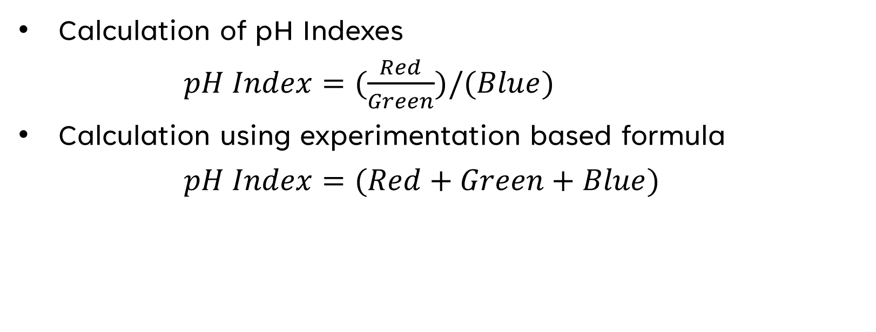
Features Extraction
Calculation of pH Indexes
$pH Index=(\frac{Red}{Green})/(Blue)$
Calculation using experimentation based formula
$pH Index=(Red+Green+Blue)$
1/27/2022

Slide 9
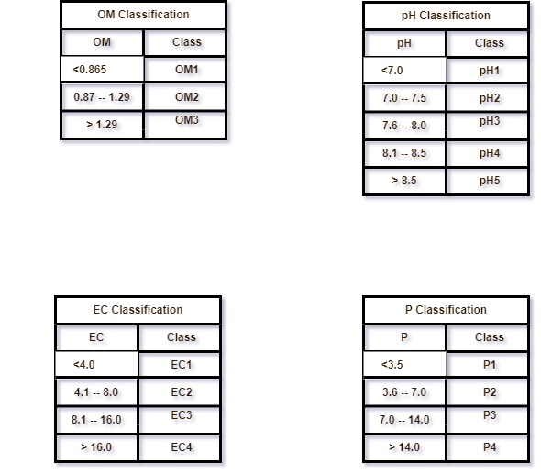
Discretization
By using soil laboratory manual
1/27/2022

Slide 10
Methodology
Artificial neural networks (ANN) models (8)
Support Vector Regression (SVR) models (8)
Decision Tree Regression (DTR) models (8)
Random Forest Regression (RFR) models (8)
Convolution neural network (CNN) regression models (4)
Convolution neural network (CNN) classification models (4)
Total models are 40
Each model is trained for each parameter separately
1/27/2022

Slide 11
Libraries and tools
TensorFlow
Sklearn
Pandas
NumPy
OpenCV
Cuda
Keras
1/27/2022

Slide 12
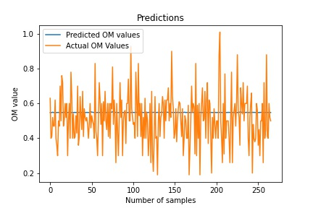
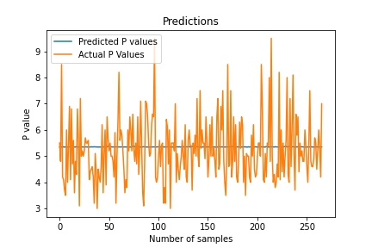
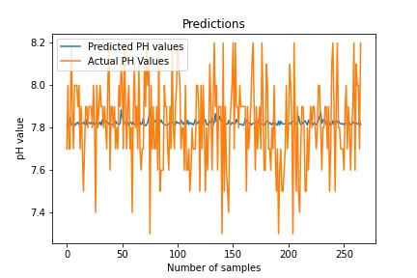
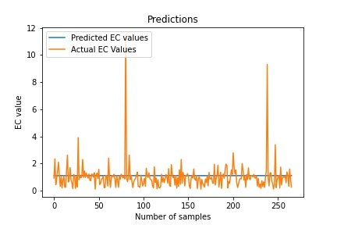
ANN Regression Models Visualizations on pH Indexes
1/27/2022

Slide 13
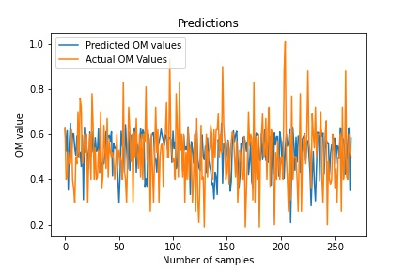
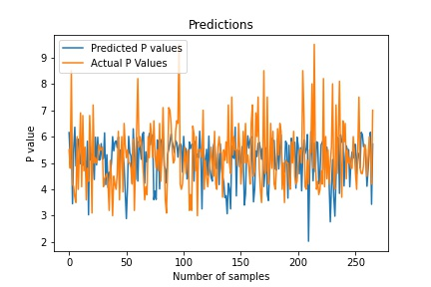
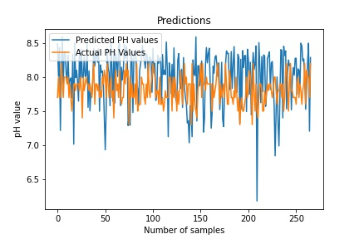
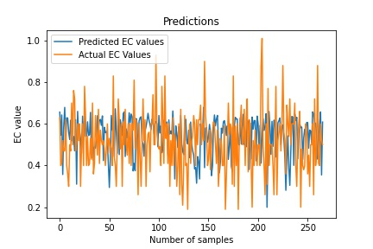
ANN Regression Models Visualizations on Formula
1/27/2022

Slide 14
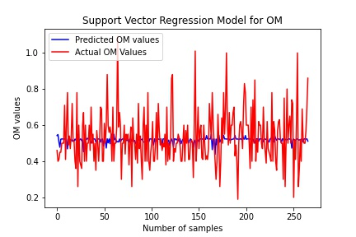
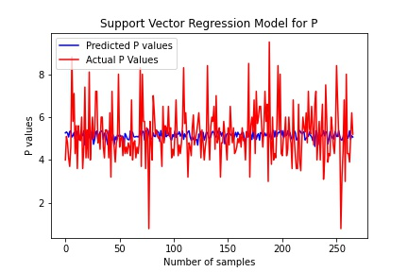
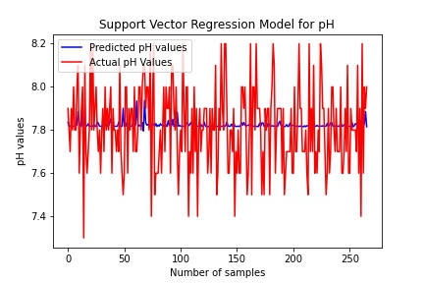
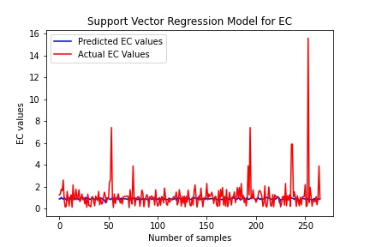
SVR Regression Models Visualizations on pH Indexes
1/27/2022

Slide 15
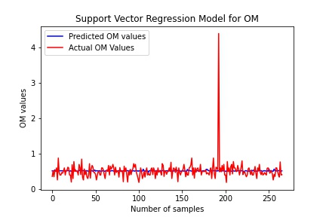
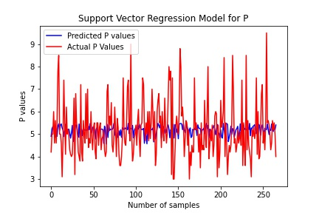
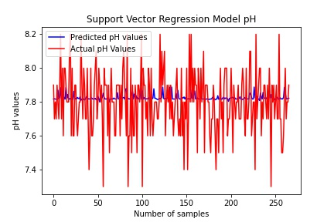
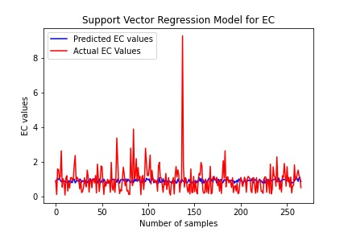
SVR Regression Models Visualizations on Formula
1/27/2022

Slide 16
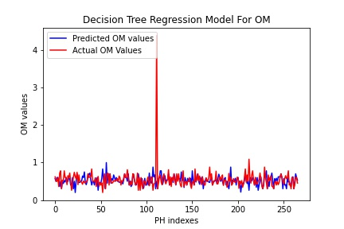
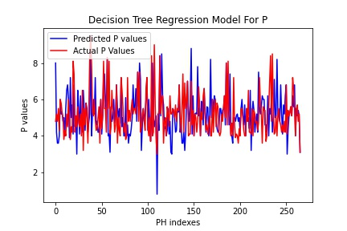
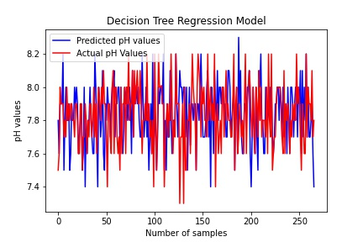
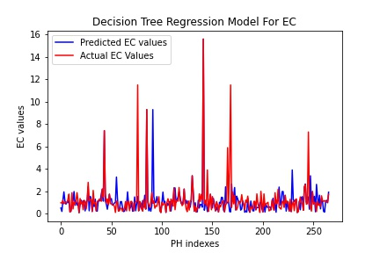
DTR Regression Models Visualizations on pH Indexes
Number of samples
Number of samples
Number of samples
1/27/2022

Slide 17
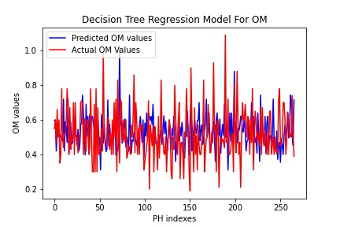
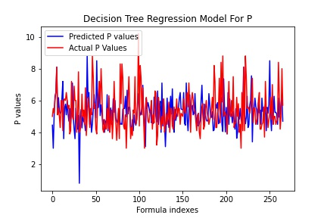
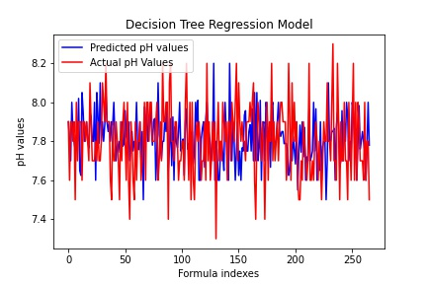
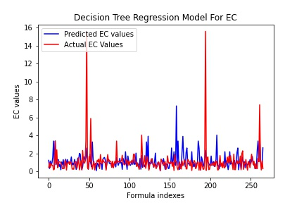
DTR Regression Models Visualizations on Formula
Number of samples
Number of samples
Number of samples
Number of samples
1/27/2022

Slide 18
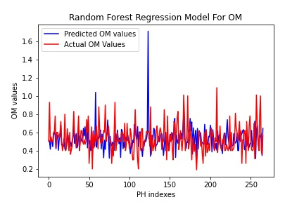
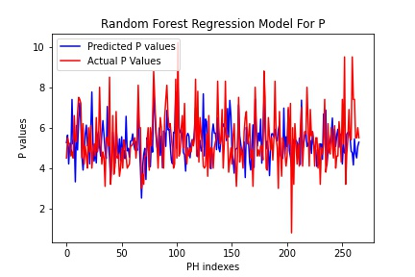
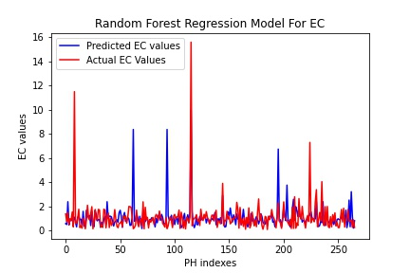
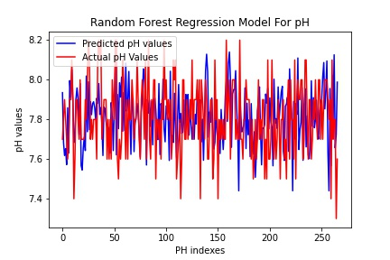
RFR Regression Models Visualizations on pH Indexes
Number of samples
Number of samples
Number of samples
Number of samples
1/27/2022

Slide 19
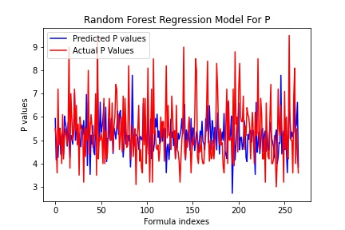
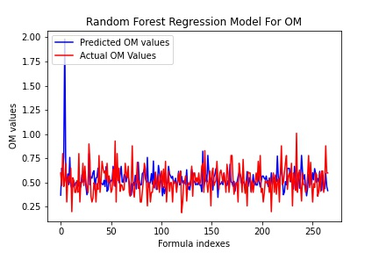
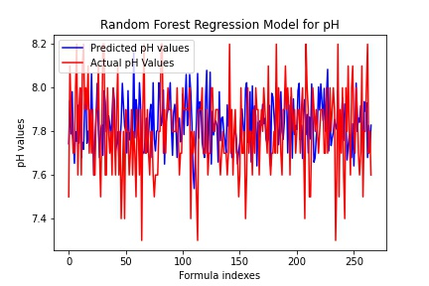
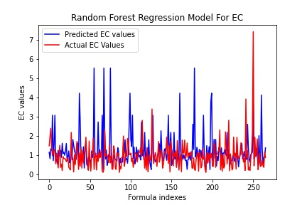
RFR Regression Models Visualizations on Formula
Number of samples
Number of samples
Number of samples
Number of samples
1/27/2022

Slide 20
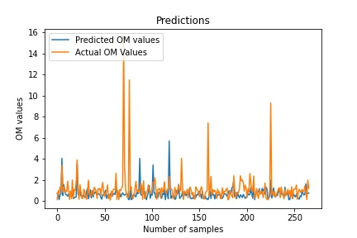
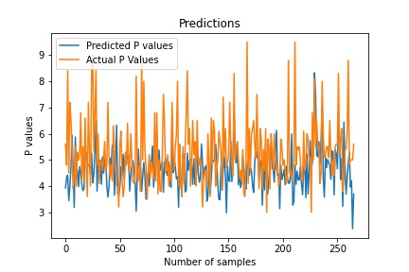
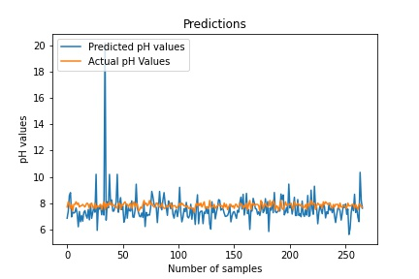
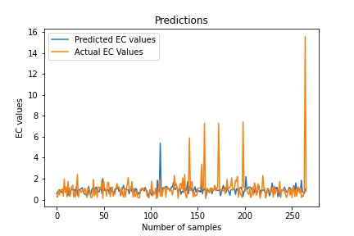
CNN Regression Models Visualizations
1/27/2022

Slide 21
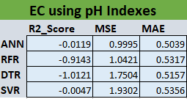
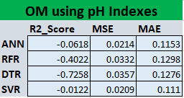
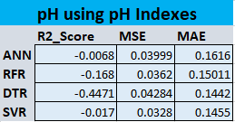
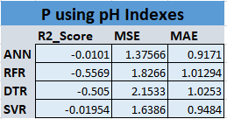
Regression Models Evaluations on pH Indexes
1/27/2022

Slide 22
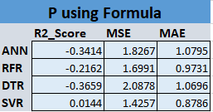
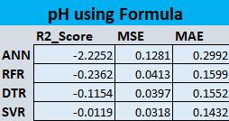
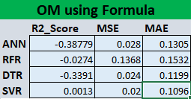
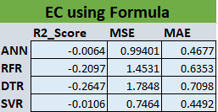
Regression Models Evaluations on Formula
1/27/2022

Slide 23

Regression Models Evaluations CNN
OM, EC, P and pH evaluations scores on CNN
1/27/2022

Slide 24

CNN Classification Models Evaluations
OM, EC, P and pH evaluations scores on CNN
1/27/2022

Slide 25
Future plan
Mobile application
NPK sensor (7 in one) testing
1/27/2022

Slide 26
Timeline
Documentation and testing
Feb 01, 2022
Literature Review for NPK sensor & parallel learning flutter
Feb 16, 2022
NPK sensor testing
March 01, 2022
Build mobile application
March 16, 2022
Build mobile application
April 01, 2022

Slide 27
Questions ☺

Slide 28
Thanks ☺

Slide 29
References
2022 Cost of Soil Testing | Price of Soil Quality Testing and Analysis – HomeAdvisor
Soil sampling using mobile - Google Search
Vinay Kumar, B. K. Vimal, Rakesh Kumar, and Mukesh Kumar. Determination of soil ph by using digital image processing technique. Journal of Applied and Natural Science, 6:14–18, 2014.
CS ManikandaBabu and M Arun Pandian. Determination of physical and chemical characteristics of soil using digital image processing. DIGITAL IMAGE PROCESSING, 1:2, 2016.
AV Guilalas, M Devoor, M Mizoguchi International Journal of . . . , and 2019. Determination of soil ph using digital image processing. 2019
Final-Year-Project-Soil-Analysis-using-machine-learning/Soil Lab manual.pdf at master · yousaf2018/Final-Year-Project-Soil-Analysis-using-machine-learning (github.com)

